Slide 1
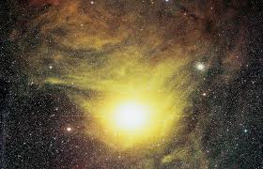
What do we use to measure distance to stars when parallax doesn’t work?

Slide 2
WALT: What affects how brightly a start appears on Earth? Grades C-A*
recall that the luminosity of a star depends on its temperature and its size – C
explain qualitatively why the observed intensity of light from a star (as seen on Earth) depends on the star’s luminosity and its distance from Earth – A*

Slide 3
Using the parallax method of measuring distance to the stars does not give a very accurate result when stars are more than 300 parsec (1000 light years) away.
Even the closest star only has a parallax angle of less than one second of arc. Most stars and galaxies in the Universe are farther away than this.

Slide 4
Luminosity
Luminosity = Total energy emitted by a star at all wavelengths from gamma radiation to radio waves.
Sun
Emits 500 million million million MJ of energy per second
Luminosity = 500 million million million MJ
You don’t need to know this figure!

Slide 5
Luminosity depends on:
size of the star
temperature of the star

Slide 6
Luminosity variables – size of star
For stars with the same surface temperature the bigger the star the more energy it gives out.
A star with double the radius of another one will have an area four times as great and so have a luminosity four times greater than the first star
R2
Double the radius
R
Radius | x2
Area | x4
Luminosity | x4

Slide 7
Luminosity and size
In a darkened room, shine a bright light through two small pinholes in a piece of opaque black card or blackout blind fabric.
The pinholes have different sizes. Viewed from a distance, they both look like points of light, and students should note that one is brighter than the other. On closer inspection, they can see that the brighter one is the larger one.
Two stars that have the same temperature (so emit light of the same colour, and the same amount per unit surface area) will have different luminosities if they are different sizes. Seen from a large distance, both appear as point sources, but the larger (more luminous) one appears brighter.

Slide 8
Luminosity variables – temp of star
For stars of the same size the hotter the star the more energy it gives out.
A star with a temperature of double another one will have a luminosity sixteen times greater.
T2
Double the temperature
T
Temperature | x2
Luminosity | x16

Slide 9
Procedure
Connect a clear headlamp bulb to a low-voltage power supply.
Gradually increase the voltage from zero to slightly beyond its maximum-rated voltage.
Note: at first the filament glows dull red and the bulb feels barely warm. As the voltage is increased the bulb glows more brightly, has a whiter colour, and feels hotter.

Slide 10
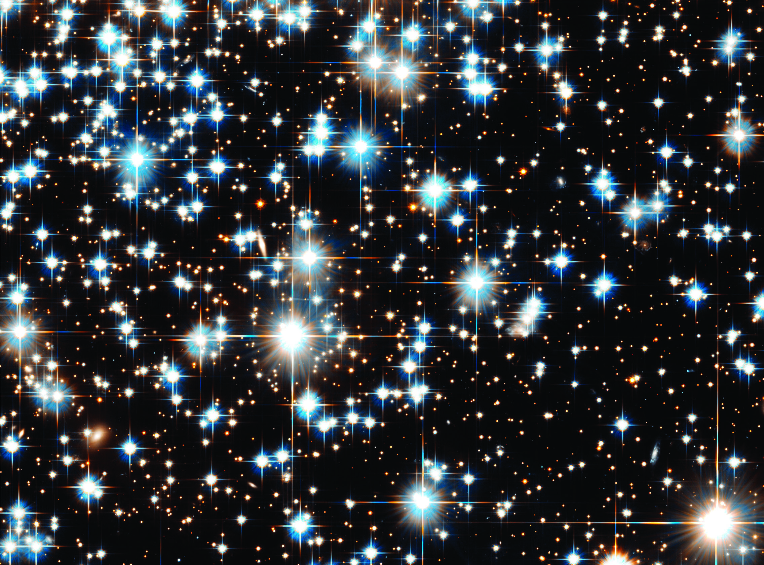
Brightness
Brightness = how bright a star appears when seen from the Earth.
Brightness depends on:
luminosity of the star
distance of the star from the Earth

Slide 11
These stars are all roughly 8200 light-years from Earth. They have a range of luminosities, giving a range of observed brightness.

Slide 12
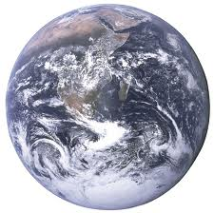
Brightness
For two stars of the same luminosity with one star double the distance of the other from the Earth the closer star will look four times brighter.
D2
D
D2
Double the distance from earth
D
Distance | x2
Luminosity | x ¼

Slide 13
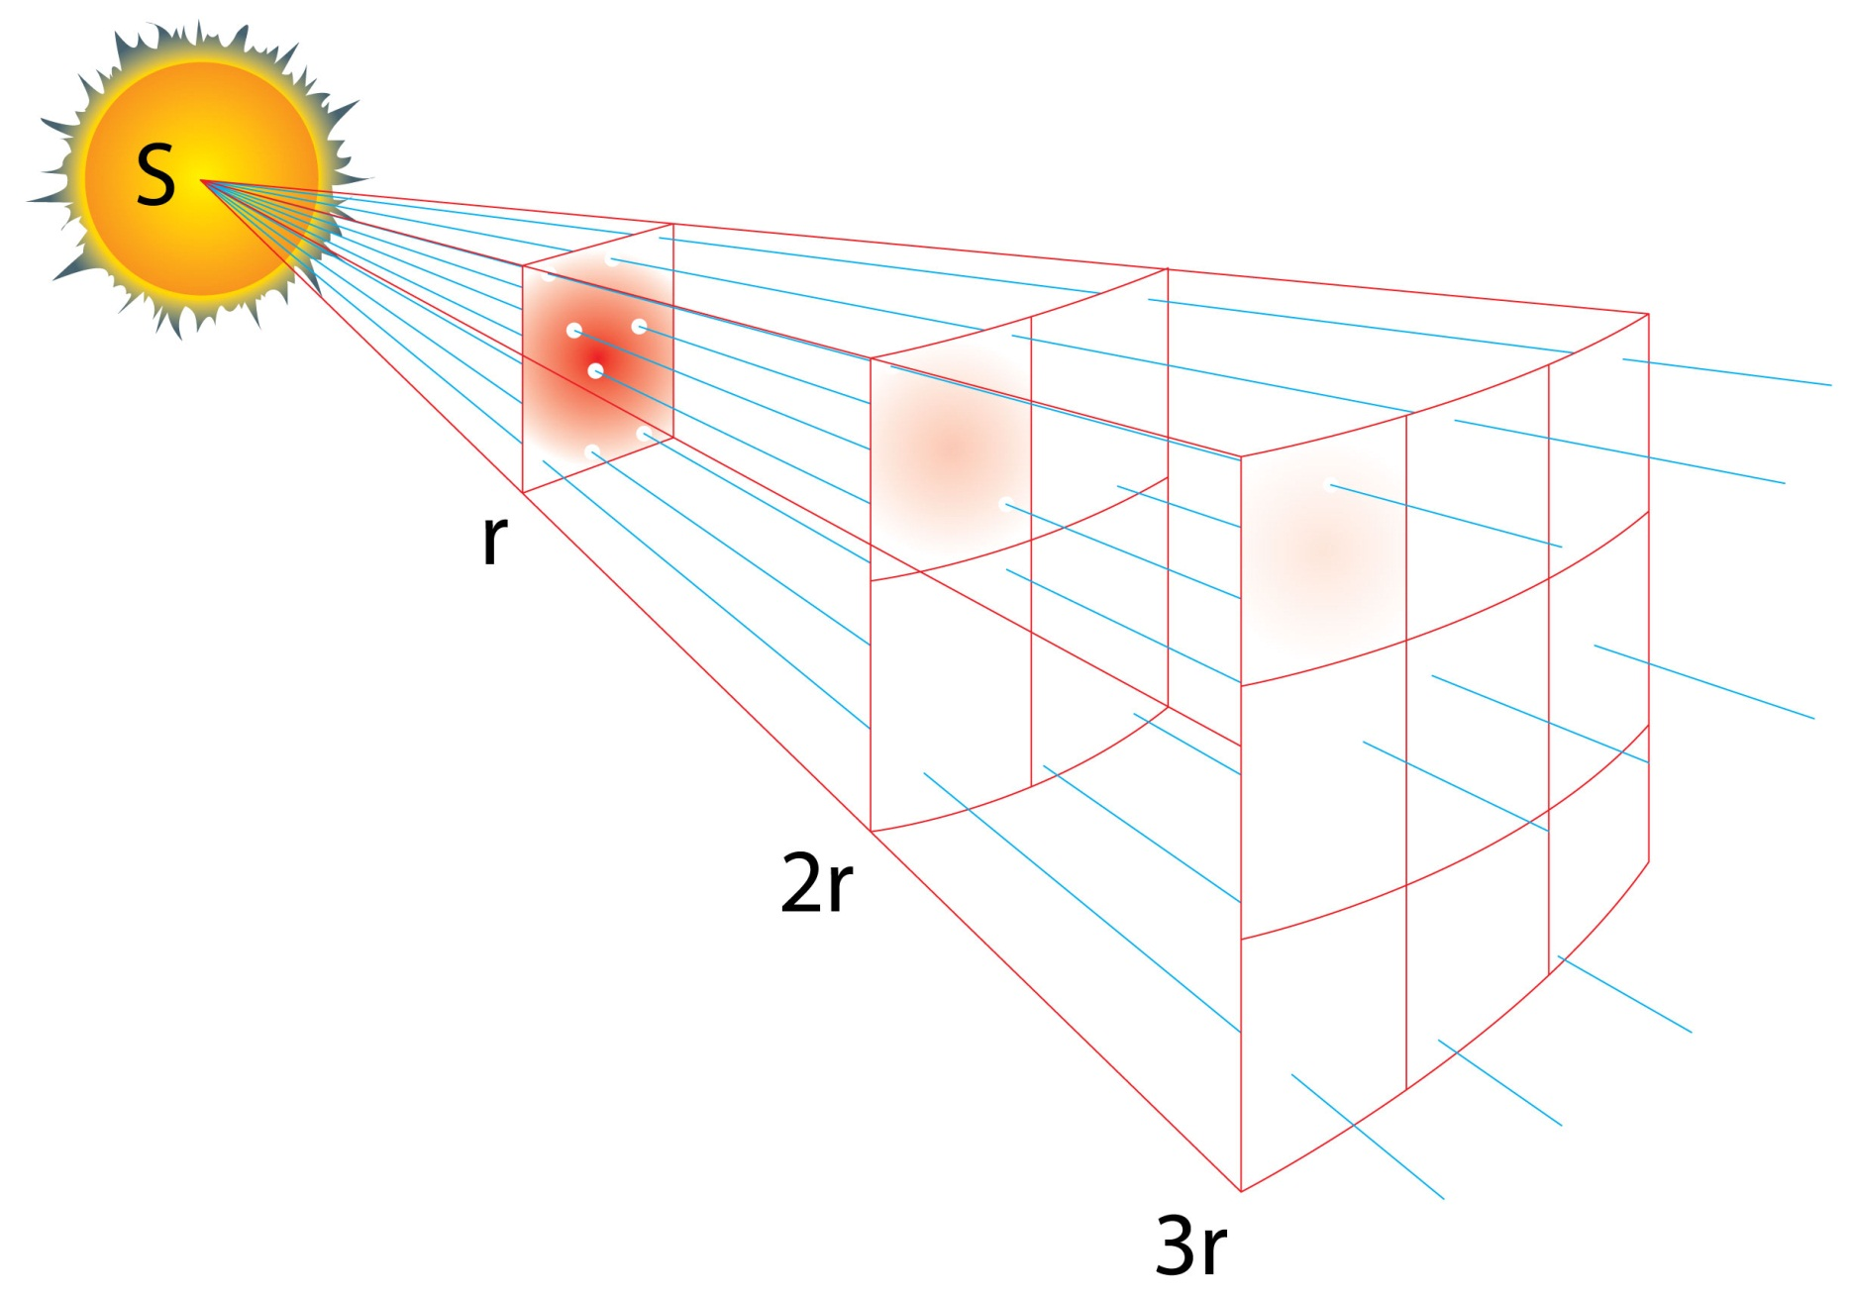
Light spreads out, so the more distant a source is the less bright it appears.

Slide 14
ILT A
Treat this as a 6-mark question

Slide 15
A light meter measures the brightness of the light shining onto its detector.
The brightness (sometimes called intensity) depends on the luminosity of the light source and its distance from the meter.
Astronomers can estimate an object’s distance by measuring its brightness and knowing (or assuming) its luminosity.

Slide 16
Use a light meter to measure the brightness at various distances from a lamp.
Plot a graph showing how brightness varies with distance.
Draw a smooth curve to show the trend of your measurements.
Put the light meter at a distance in between two positions that you have measured.
Note its reading.
Use your graph to predict the distance that would give this reading
Measure the distance and check whether your prediction was right.

Slide 17
It is unlikely your results will be linear, so the reading is probably not proportional to brightness and it would not be reasonable to expect the measurements to follow an inverse-square law.
That is, doubling the distance will probably not reduce the meter reading to one quarter of its value as would be theoretically predicted for a point source.

Slide 18
Suppose you repeated the experiment with a more luminous lamp (a more powerful one). How do you think your light-meter readings would change?
Write a few sentences explaining how astronomers can use brightness measurements to estimate distances.
Explain why astronomers can only use this method to estimate distance if they are pretty sure of the object’s luminosity.

Slide 19
Suppose you repeated the experiment with a more luminous lamp (a more powerful one). How do you think your light-meter readings would change?
Light meter readings would be higher at each distance. The lamp would appear to be closer than it is.

Slide 20
Write a few sentences explaining how astronomers can use brightness measurements to estimate distances.
If the brightness and distance of one star is known, other stars can be compared to that star.
The further they are away, the dimmer they will appear, if they have the same luminosity.

Slide 21
Explain why astronomers can only use this method to estimate distance if they are pretty sure of the object’s luminosity.
If the luminosity is brighter than thought, then the star may appear to be closer than it really is.

Slide 22
ILT answer
If two stars are exactly the same, the one that is further away will look dimmer.
The temperature and the size of the star will also change its brightness.

