Slide 1
OCR 21st Century Science
Unit P4b Revision
Forces

Slide 2

What is a force?
A force is a “push” or a “pull”. Some common examples:
Air resistance/drag – a contact force that acts against anything moving through air or liquid
Weight (mg) – pulls things towards the centre of the Earth
Friction – a contact force that acts against anything moving
Upthrust – keeps things afloat

Slide 3
Action and reaction summary
Consider a rocket leaving the Earth’s atmosphere:
A chemical reaction happens inside the rocket that ______ out exhaust gases. There is an equal and ______ reaction to this force – this _______ acts on the rocket and pushes it _______. The same process happens in ____ engines.
Words – jet, pushes, reaction, upwards, opposite

Slide 4
Balanced and Unbalanced forces
Reaction
Consider a camel standing on a road. What forces are acting on it?
These two forces would be equal – we say that they are BALANCED. The camel doesn’t move anywhere.
Weight

Slide 5
Balanced or Unbalanced?
1) This animal is either ________ or moving with _______ _____…
2) This animal is getting ________…
3) This animal is getting _______….
4) This animal is also either _______ or moving with ________ ______..
Words - Stationary, faster, slower or constant speed?

Slide 6
Resultant forces
Calculate the resultant force of the following:
500N
100N
700N
600N
50N
700N
700N
800N
800N
200N
100N

Slide 7
summary (finish off the sentences)
If an object is stationary and has NO resultant force on it the object will…
If an object is stationary and a resultant force acts on it the object will…
If an object is already moving and NO resultant force acts on it the object will…
If an object is already moving and a resultant force acts on it the object will…
…accelerate in the direction of the resultant force
…continue to move at the same speed and the same direction
…continue to stay stationary
…accelerate in the direction of the resultant force

Slide 8
Momentum
Any object that has both mass and velocity has MOMENTUM. Momentum (symbol “p”) is simply given by the formula:
P
Momentum = Mass x Velocity
(in kgm/s) (in kg) (in m/s)
M
V
What is the momentum of the following?
A 1kg football travelling at 10m/s
A 1000kg Ford Capri travelling at 30m/s
A 20g pen being thrown across the room at 5m/s
A 70kg bungi-jumper falling at 40m/s

Slide 9
Force and change in momentum
To calculate the change the momentum of an object you need to know two things – how much force acts and how long it acts for:
Force = Change in momentum
(in kgm/s)
mv-mu
(in N)
Time
(in s)
F
T
For example, Ronaldo takes a free kick by kicking a stationary football with a force of 40N. If the ball has a mass of 0.5kg and his foot is in contact with the ball for 0.1s calculate:
The change in momentum of the ball (its impulse),
The speed the ball moves away with

Slide 10
Example questions
Paddy likes playing golf. He strikes a golf ball with a force of 80N. If the ball has a mass of 200g and the club is in contact with it for 0.2s calculate a) the change in momentum of the golf ball, b) its speed.
Courtney thinks it’s funny to hit tennis balls at Kit. She strikes a serve with a force of 30N. If the ball has a mass of 250g and the racket is in contact with it for 0.15s calculate the ball’s change in momentum and its speed.
Tom takes a dropkick by kicking a 0.4kg rugby ball away at 10m/s. If his foot was in contact with the ball for 0.1 seconds calculate the force he applied to the ball.
Jenny strikes a 200g golf ball away at 50m/s. If she applied a force of 50N calculate how long her club was in contact with the ball for.
16Kgm/s, 80m/s
4.5Kgm/s, 18m/s
40N
0.2s

Slide 11
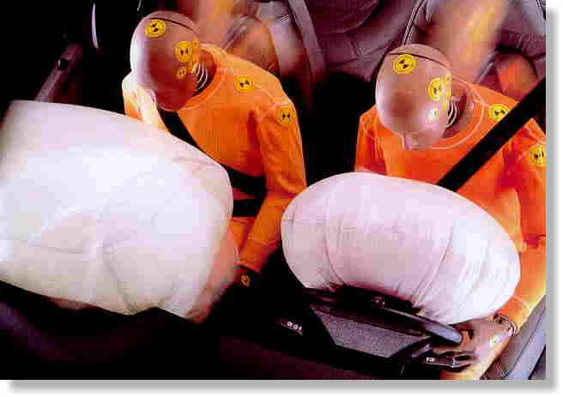
Safety features
Let’s use this equation to explain how airbags work:
Δmv
F
T
Basically:
The change in momentum is the same with or without an airbag
But having an airbag increases the time of the collision
Therefore the force is reduced

Slide 12
Terminal Velocity

Slide 13
Terminal Velocity summary
10/04/2014
Consider a skydiver:
At the start of his jump the air resistance is _______ so he _______ downwards.
2) As his speed increases his air resistance will _______
3) Eventually the air resistance will be big enough to _______ the skydiver’s weight. At this point the forces are balanced so his speed becomes ________ - this is called TERMINAL VELOCITY
Words – increase, small, constant, balance, accelerates

Slide 14
Terminal Velocity summary
10/04/2014
Consider a skydiver:
4) When he opens his parachute the air resistance suddenly ________, causing him to start _____ ____.
5) Because he is slowing down his air resistance will _______ again until it balances his _________. The skydiver has now reached a new, lower ________ _______.
Words – slowing down, decrease, increases, terminal velocity, weight

Slide 15
Kinetic energy
Any object that moves will have kinetic energy.
The amount of kinetic energy an object has can be found using the formula:
Kinetic energy = ½ x mass x velocity squared
in J in kg in m/s
KE = ½ mv²

Slide 16
Example questions
Bex drives her car at a speed of 30m/s. If the combined mass of her and the car is 1000kg what is her kinetic energy?
Emma rides her bike at a speed of 10m/s. If the combined mass of Emma and her bike is 80kg what is her kinetic energy?
Rob is running and has a kinetic energy of 750J. If his mass is 60kg how fast is he running?
Josh is walking to town. If he has a kinetic energy of 150J and he’s walking at a pace of 2m/s what is his mass?
450,000J
4000J
5m/s
75kg

Slide 17
Gravitational Potential Energy
To work out how much gravitational potential energy (GPE) an object gains when it is lifted up we would use the simple equation…
GPE = Weight x Change in height
(Joules) (newtons) (metres)
(Remember - W=mg)
GPE
mg
ΔH

Slide 18
Some example questions…
How much gravitational potential energy have the following objects gained?:
A brick that weighs 10N lifted to the top of a house (10m),
A 1,000kg car lifted by a ramp up to a height of 2m,
A 70kg person lifted up 50cm by a friend.
How much GPE have the following objects lost?:
A 2N football dropping out of the air after being kicked up 30m,
A 0.5N egg falling 10m out of a bird nest,
A 1,000kg car falling off its 200cm ramp.
100J
20KJ
350J
60J
5J
20KJ

Slide 19
Work done
When any object is moved around work will need to be done on it to get it to move (obviously).

Slide 20
Example questions
Hannah pushes a book 5m along the table with a force of 5N. She gets tired and decides to call it a day. How much work did he do?
Courtney lifts a laptop 2m into the air with a force of 10N. How much work does she do? What type of energy did the book gain?
Tom does 200J of work by pushing a wheelbarrow with a force of 50N. How far did he push it? What type of energy did the wheelbarrow gain?
Dan cuddles his cat and lifts it 1.5m in the air. If he did 75J of work how much force did he use?
Simon drives his car 1000m. If the engine was producing a driving force of 2000N how much work did the car do?
25J
20J, GPE
4m, KE
50N
2MJ

Slide 21
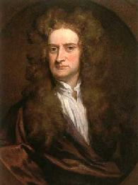
Stopping a car…
10/04/2014
What happens inside the car when it stops?
In order to stop this car the brakes must “do work”. This work is used to reduce the kinetic energy of the vehicle.
Amount of energy transferred = work done

Slide 22
An example question…
10/04/2014
10/04/2014
This car can apply a maximum braking force of 10,000N. If the car’s mass is 1000Kg how far is its stopping distance when it is travelling at a speed of 15m/s (roughly 30mph) and 30m/s (roughly 60mph)?
15m/s = 11.25m stopping distance
30m/s = 45m stopping distance (4 times greater)

Slide 23
A Practical Example of Doing Work
10/04/2014
Consider a rocket re-entering the Earth’s atmosphere:
The rocket would initially have a very high _______ energy. This energy would then _____ due to friction caused by collisions with _______ in the atmosphere. These collisions would cause the rocket to ____ up (_____ is “being done” on the rocket). To help deal with this, rockets have special materials that are designed to lose heat quickly.
Words – work, kinetic, particles, heat, decrease

Slide 24
Kinetic energy and Gravitational potential energy

Slide 25
Energy Changes in Roller Coasters
10/04/2014
1) Electrical energy is transferred into gravitational potential energy
3) Kinetic energy is transferred back into gravitational potential energy
2) Gravitational potential energy is transferred into kinetic energy

Slide 26
Dropping objects
If I drop this ball 1m how fast will it be going when it hits the floor?
Use GPE at top = Kinetic energy at bottom
mgΔh = ½mv²
gΔh = ½v²
10 x 1 = ½ x v²
1m
v² = 20
v = 4.5m/s

