Slide 1
OCR 21st Century Science
Unit P6 a Revision
Radioactive materials

Slide 2
The structure of the atom

Slide 3
Introduction to Radioactivity
Some substances are classed as “radioactive” – this means that they are unstable and continuously give out radiation at random intervals:
Radiation
The nucleus is more stable after emitting some radiation – this is called “radioactive decay”. This process is NOT affected by temperature or other physical conditions.

Slide 4
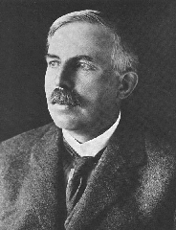
Structure of the atom
10/04/2014
A hundred years ago people thought that the atom looked like a “plum pudding” – a sphere of positive charge with negatively charged electrons spread through it…
Ernest Rutherford, British scientist:
I did an experiment (with my colleagues Geiger and Marsden) that proved this idea was wrong. I called it the “Scattering Experiment”

Slide 5
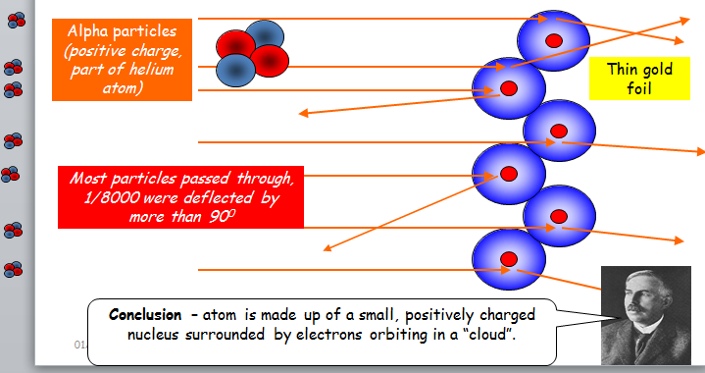
The Rutherford Scattering Experiment
10/04/2014
…………………………………………………………………………………………………………………………………………………………………………………………………………………………………………………………………………………………………………………………………………………………………………………….

Slide 6
Radioactivity
Radioactivity

Slide 7
Isotopes
An isotope is an atom with a different number of neutrons:
Notice that the mass number is different. How many neutrons does each isotope have?
16
17
18
O
O
O
8
8
8
Each isotope has 8 protons – if it didn’t then it just wouldn’t be oxygen any more.
A “radioisotope” is simply an isotope that is radioactive – e.g. carbon 14, which is used in carbon dating.

Slide 8
Isotopes

Slide 9
Types of radiation summary
1) Alpha (α) – an atom decays into a new atom and emits an alpha particle (2 protons and 2 ______ – the nucleus of a ______ atom)
Unstable nucleus
New nucleus
Alpha particle
2) Beta (β) – an atom decays into a new atom by changing a neutron into a _______ and electron. The fast moving, high energy electron is called a _____ particle.
Beta particle
Unstable nucleus
New nucleus
3) Gamma – after α or β decay surplus ______ is sometimes emitted. This is called gamma radiation and has a very high ______ with short wavelength. The atom is not changed.
Unstable nucleus
New nucleus
Gamma radiation
Words – frequency, proton, energy, neutrons, helium, beta

Slide 10
Alpha radiation
Alpha Radiation

Slide 11
Beta radiation
Beta Radiation

Slide 12
Beta radiation
Beta radiation summary

Slide 13
Gamma radiation
Gamma radiation

Slide 14
Gamma radiation
Gamma radiation summary

Slide 15
Blocking Radiation
Each type of radiation can be blocked by different materials:
α
β
γ
Sheet of paper (or 6cm of air will do)
Few mm of aluminium
Few cm of lead

Slide 16
Penetration of radiation
Blocking radiation summary

Slide 17
Ionisation
Ionisation

Slide 18
Ionisation
Ionisation summary

Slide 19
Half life
10/04/2014
The decay of radioisotopes can be used to measure the material’s age. The HALF-LIFE of an atom is the time taken for HALF of the radioisotopes in a sample to decay…
= radioisotope
= new atom formed
After 1 half life half have decayed (that’s 8)
After 2 half lives another half have decayed (12 altogether)
After 3 half lives another 2 have decayed (14 altogether)
At start there are 16 radioisotopes

Slide 20
Half life graph
…………………………………………………………………………………………………………………………………………………………………………………………………………………………………………………………………………………………………………………………………………………………………………………….

Slide 21
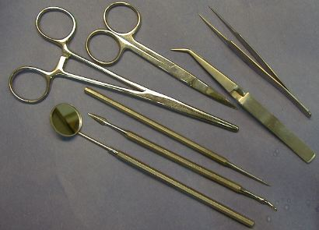

Uses of Radioactivity 1
10/04/2014
Sterilising medical instruments
Gamma rays can be used to kill and sterilise germs without the need for heating. The same technique can be used to kill microbes in food so that it lasts longer.

Slide 22

Uses of Radioactivity 2 - Tracers
10/04/2014
A tracer is a small amount of radioactive material used to detect things, e.g. a leak in a pipe:
Gamma source
The radiation from the radioactive source is picked up above the ground, enabling the leak in the pipe to be detected.
Tracers can also be used in medicine to detect tumours:
For medicinal tracers, you would probably use a beta source with a short half life – why?

Slide 23
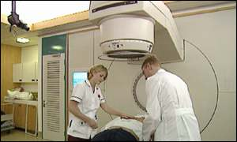
Uses of Radioactivity 3 - Treating Cancer
10/04/2014
High energy gamma radiation can be used to kill cancerous cells. However, care must be taken in order to enure that the gamma radiation does not affect normal tissue as well.
Radioactive iodine can be used to treat thyroid cancer. Iodine is needed by the thyroid so it naturally collects there. Radioactive iodine will then give out beta radiation and kill cancerous cells.
What sort of half life would you want the radioactive iodine to have?

Slide 24
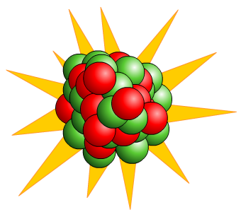
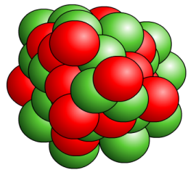
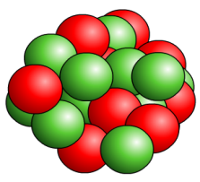
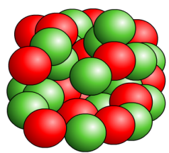

For fission to occur the uranium-235 or plutonium-239 nucleus must first absorb a neutron
The nucleus undergoing fission splits into two smaller nuclei and two or three neutrons and energy is released.
fission
+
➔
➔
+
+
Uranium
235
+
neutron
➔
uranium
236
➔
Strontium
90
+
Xenon
144
+
neutrons
A slow moving neutron is absorbed by the nucleus
The nucleus splits into two almost equal parts
This releases large amounts of energy
Two or three new neutrons are released

Slide 25

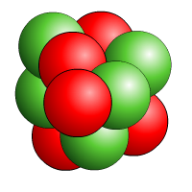


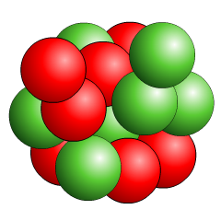
The neutrons may go on to start a chain reaction
Nuclear fission results in a chain reaction because each time a nucleus splits it releases more neutrons, which can go on and cause more fission
reactions to occur...
and so on.
This is why a chain reaction releases a lot
of energy so rapidly.
If a chain reaction
is uncontrolled,
heat builds up very quickly.
A chain reaction must be controlled to maintain a steady output of heat.
➔
➔
+
➔
➔
+
+
➔
➔
+
➔
➔

Slide 26
Fission summary

Slide 27

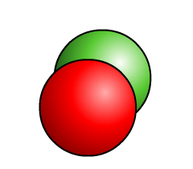
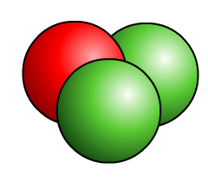
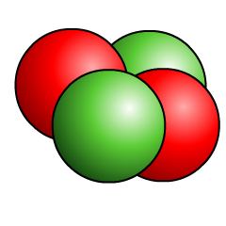
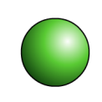
Nuclear fusion is the joining of two atomic nuclei to form a larger one.
+
➔
➔
+
deuterium
+
tritium
➔
fusion
➔
helium
+
neutron

Slide 28
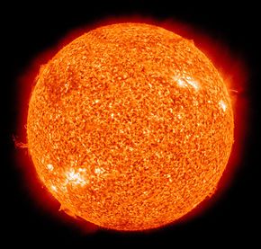
Nuclear fusion is the process by which energy is released in stars.

Slide 29
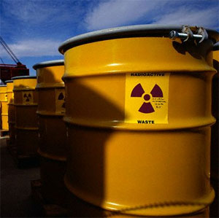
3 Types of nuclear waste.
High level waste (HLW) – from ‘spent’ fuel rods.
This doesn't last long.
Intermediate level waste (ILW) – the amount of this is growing.
Low level waste – protective clothing and medical equipment.

Slide 30
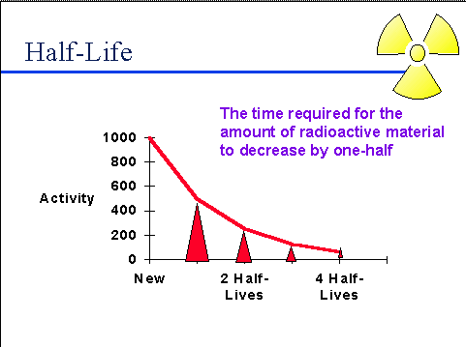
Where does intermediate level waste come from?
High level waste decays quickly at first.
Its activity falls and it becomes intermediate level waste.
It can remain radioactive for thousands of years.

