Slide 2
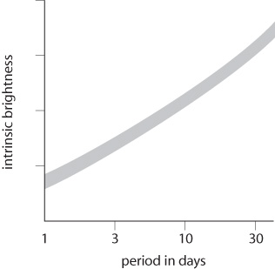
Calculating the distance to a Cepheid variable star
Measure the period – 5 days
Use the period to work out the luminosity
Measure the observed brightness
Compare the observed brightness with the luminosity to work out the distance
The period–luminosity relation for Cepheid variables

Slide 3
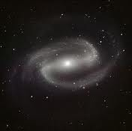
Observing nebulae and galaxies
We know from telescope observations that our galaxy (Milky Way) is made up of millions of stars.
The sun is one of the stars in our galaxy
In the 1920s astronomers were puzzled by fuzzy patches of light seen through telescopes.
They called these fuzzy patches nebulae.
Nebulae have different shapes including spirals

Slide 4
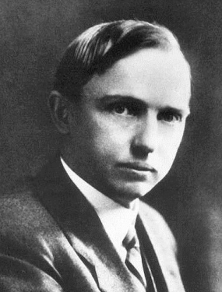
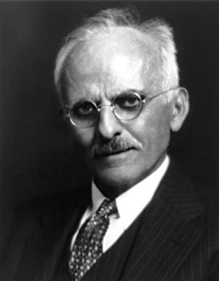
Shapeley vs. Curtis
Shapeley
Curtis
Thought Milky Way was entire universe
Thought nebulae were clouds of gas within Milky Way
Thought spiral nebulae were huge distant clusters of stars – other galaxies outside the Milky Way

Slide 5
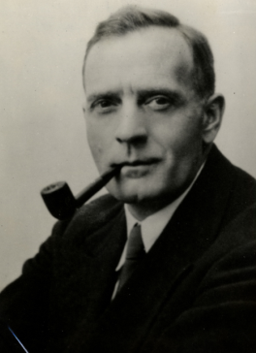
Shapeley vs. Curtis
Neither astronomer had enough evidence to win the argument
Later HUBBLE found a Cepheid variable in a spiral nebula, Andromeda.
Hubble measured the distance from Earth → star.
It was further than any star in the Milky Way galaxy
He concluded that the star was in a separate galaxy
Cepheid variable stars have been used to show that most spiral nebulae are distant galaxies, of which there are billions in the Universe.

Slide 6
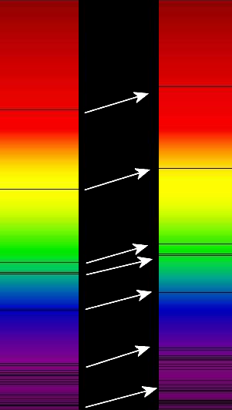
The amazing and expanding Universe!
Astronomers study absorption spectra from distant galaxies
Compared to spectra from nearby stars, the black absorption lines for distant galaxies are shifted towards the red end of the spectrum. This is REDSHIFT
Redshift shows us that galaxies are moving away from us.

Slide 7
Speed of recession
Redshift shows us that galaxies are moving away from us.
The speed of recession of a galaxy is the speed at which it is moving away from us. This can be found from the redshift of the galaxy.
(you can use either set of units)

Slide 8
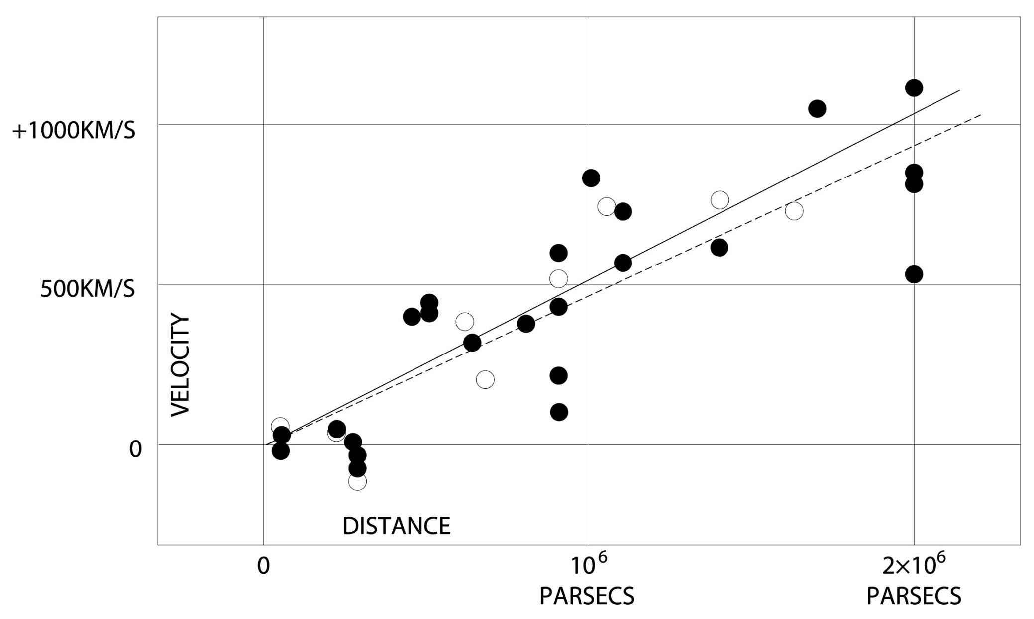
Hubble, Cepheid Variables and Recession
Hubble measured the distance to Cepheid variable stars in several galaxies.
He found the further away a galaxy is, the greater its speed of recession.

Slide 9
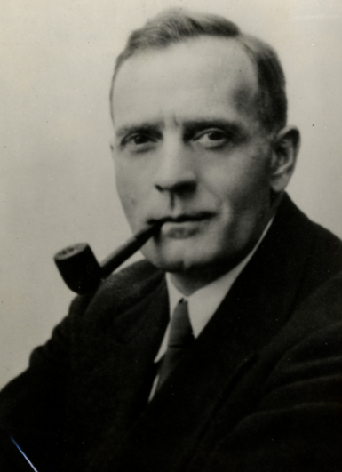
Hubble’s constant
Since Hubble, many astronomers have gathered data from Cepheid variable stars in different galaxies.
These data have given better values of the Hubble constant.
The fact that galaxies are moving away from us suggests that the Universe began with a big bang about 14 thousand million years ago.
Distant galaxies seem to be moving away faster than nearby galaxies, hence scientists conclude that space itself is expanding.

Slide 10
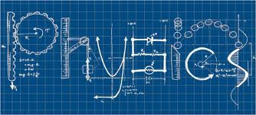
P7.4: The Sun, the stars and their surroundings

Slide 11
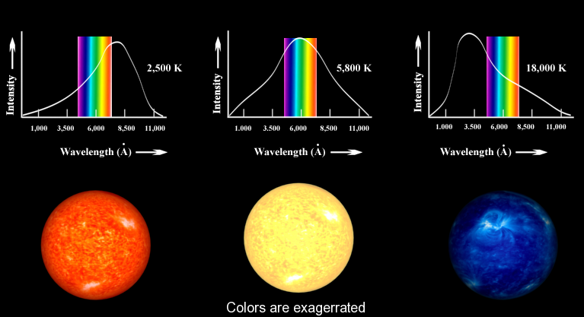
Star Spectra and Temperature
Hot objects (including stars) emit energy across all wavelengths of the EM radiation spectrum
Different stars emit different amounts of radiation and different frequencies depending on their temperature.

Slide 13
INCREASING TEMPERATURE

Slide 14
Spectrometer
Used by astronomers to:
Measure radiation emitted at each frequency
Identify the peak frequency of a star
The peak frequency gives an accurate value for the temperature of a star.
Peak frequency | = | Higher temperature

Slide 15
Identifying elements in stars
Astronomers use spectra from stars to identify their elements.
The surface of the Sun emits white light. As the light travels through the Sun’s atmosphere, atoms in this atmosphere absorb light of certain frequencies.
The light that travels on has these frequencies missing.
When the light is spread into a spectrum, there are dark lines across it.
This is the absorption spectrum of the sun

Slide 16
Identifying elements in stars
Each element produces a unique pattern of lines in its absorption spectrum
Astronomers identify the elements in stars by comparing star absorption spectra to those of elements in the lab

Slide 17
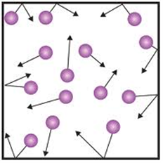
How do gases behave?
Stars are balls of hot gases
To understand stars, you need to understand gases
The particles of a gas move very quickly in random directions
When they hit the sides of a container they exert a force as they change direction → this causes gas pressure

Slide 18
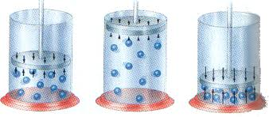
Pressure and volume
If you decrease the volume of the container, the particles hit the sides more often and the pressure increases

Slide 19
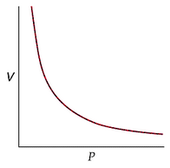
Pressure and volume
Volume and pressure are inversely proportional
For a fixed mass of gas at constant temp as volume decreases pressure increases
pressure x volume = constant

Slide 20
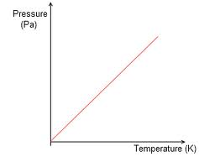
Pressure and temperature
The hotter the gas, the more energy the particles have and the faster they move
The faster the particles move, the harder and more often they hit the sides of the container.

Slide 21
Pressure and temperature
Temperature and pressure are directly proportional
For a fixed mass of gas at constant volume as temperature (K) increases pressure increases
pressure / temperature = constant

Slide 22
Cooling a gas
As a gas cools, the particles lose energy & they move more slowly
At the lowest temperatures particles stop moving and therefore would never hit the sides of the container.
Lowest theoretical temp = absolute zero (-273ºC)
X

Slide 23
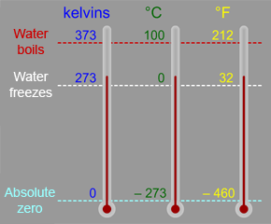
Kelvin Scale
Starts at the lowest theoretical temp = absolute zero (-273ºC)
Zero on the Kelvin scale is -273ºC = absolute zero

Slide 24
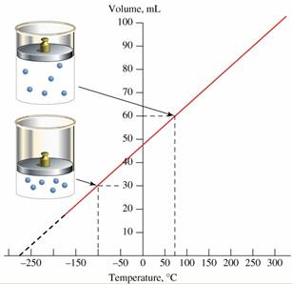
Volume and temperature
If you decrease the temperature of a gas at constant pressure, the volume decreases.
At absolute zero, the volume would theoretically be zero
For a fixed mass of gas at a fixed pressure:
As temp increases, vol increases
Volume is directly proportional to temp (K)
volume = constant
temperature

Slide 26
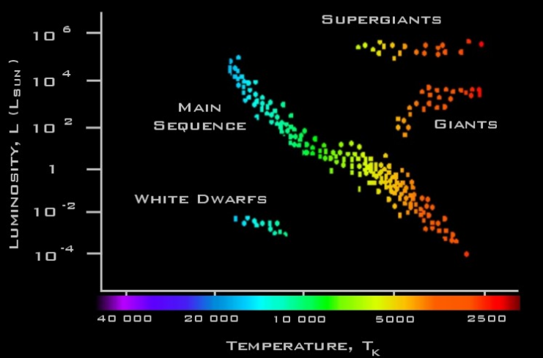
Inside stars

Slide 27
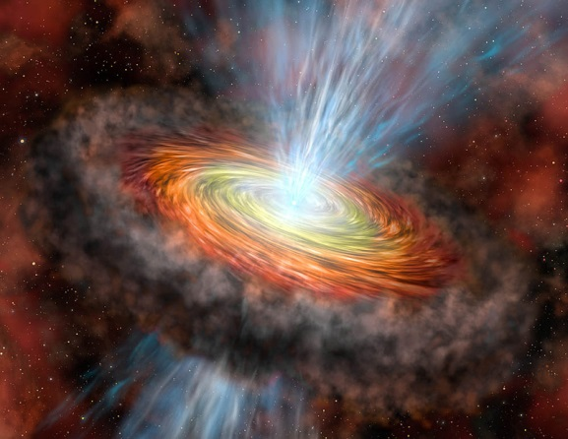
Protostars
Gravity compresses a cloud of H and He gas
The gas particles get closer and closer
The volume of the gas cloud decreases
As they get closer they move faster
Temperature and pressure increase
This mass of gas is called a protostar

Slide 28
Protostars and Nuclear Fusion
When H nuclei get close enough they form He nuclei – nuclear fusion
This process releases energy.
Protostar star when fusion begins
Nuclear fusion happens in all stars including our Sun

Slide 29
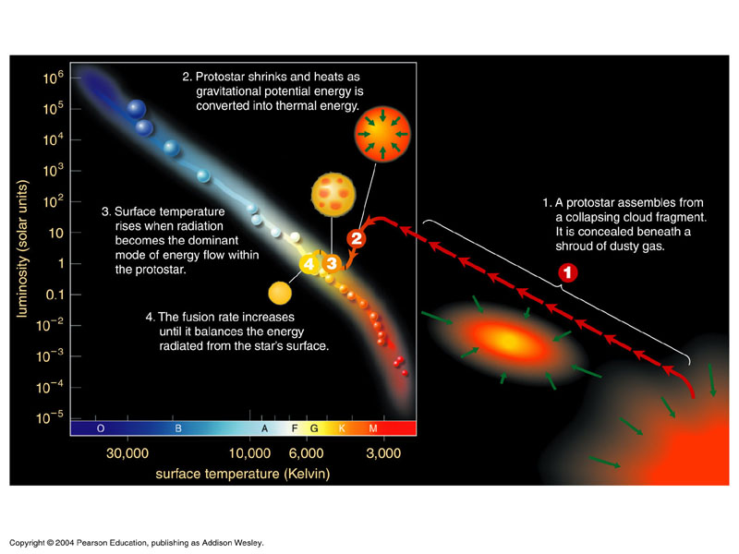

Slide 30
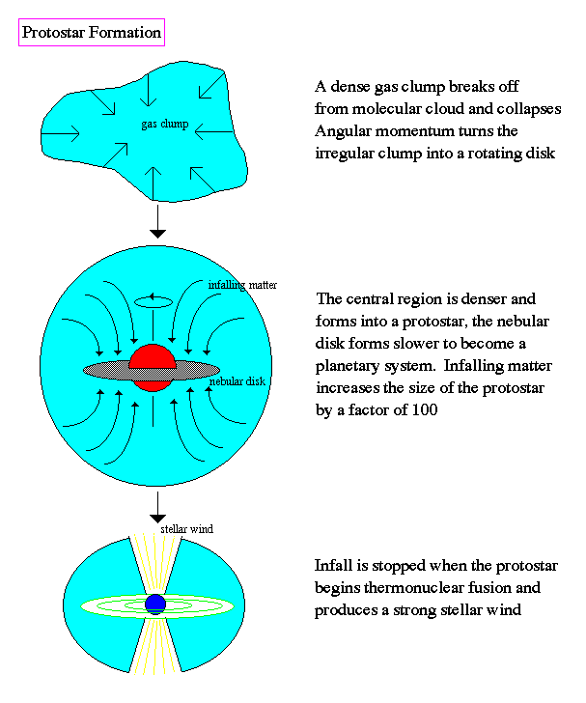
Protostar formation

Slide 31
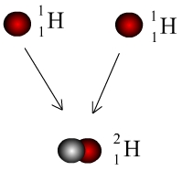
Nuclear fusion in the Sun
0
1
+ e⁺ (positron)

Slide 32
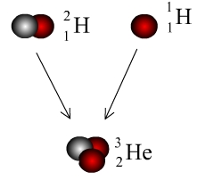
Nuclear fusion in the Sun
The product of the previous reaction may then fuse with another hydrogen nucleus to form an isotope of helium

Slide 33
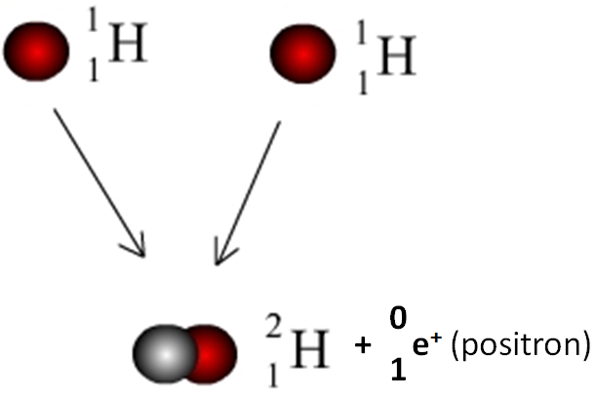
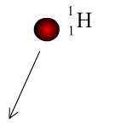

Slide 34
Positrons
Like an electron, but with a positive charge
Emitted in some nuclear reactions to conserve charge

Slide 35
Nuclear equations
You must balance:
Mass (top number)
Charge (lower numbers)
In fusion reactions the total mass of product particles is slightly less than the total mass of reactant particles.
The mass that is lost has been released as energy
You can use Einstein’s equation to calculate energy released in nuclear fusion / fission reactions
Energy released | = | mass lost | x | (speed of light in a vacuum)²

Slide 36
Inside stars

Slide 37
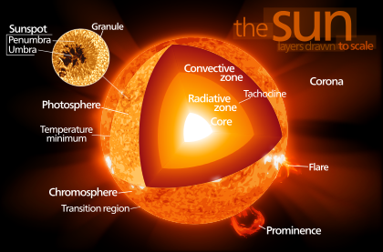
Stars which fuse H to form He are main-sequence stars (e.g. the sun)

Slide 38
Core
Radiative zone
Convective zone
Photosphere ~ surface of star

Slide 39
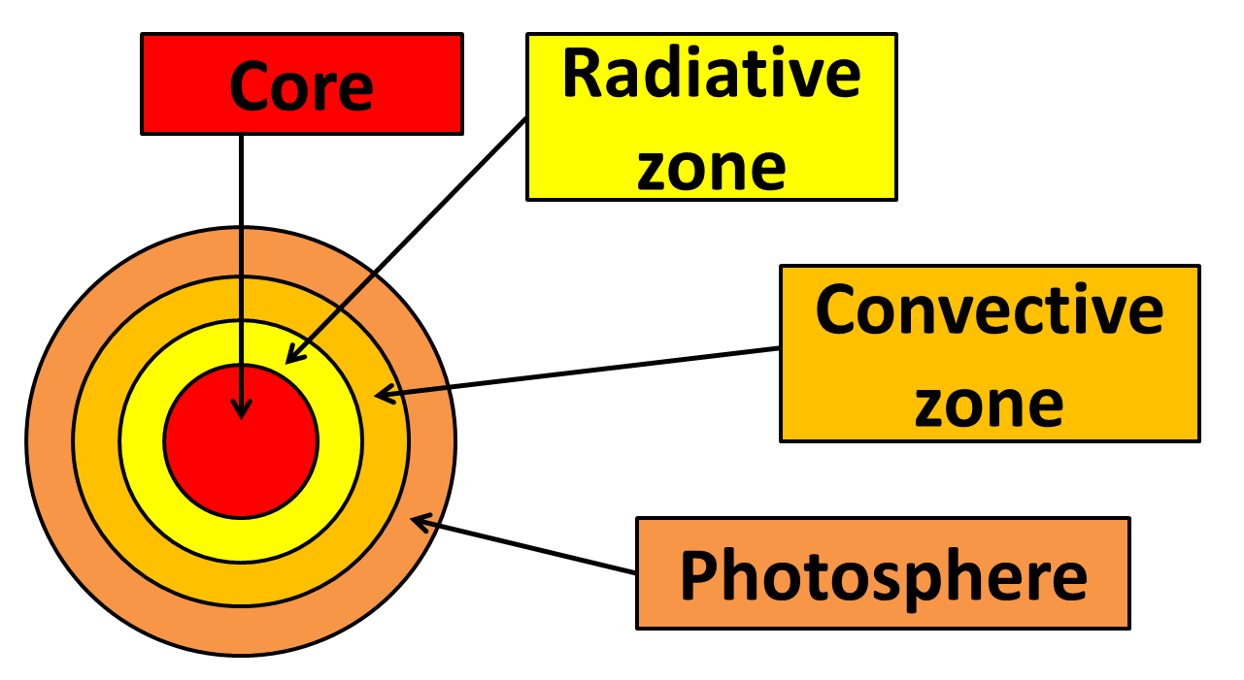
Temperature and density are highest. Most nuclear fusion happens here
Energy is transported outwards from the core by radiation
Convection currents flow here, carrying heat energy to the photosphere
Energy is radiated into space from here

Slide 40
Inside stars

Slide 41
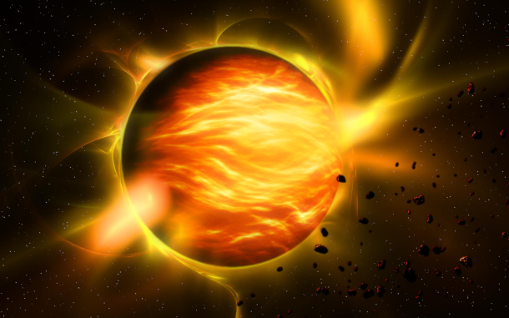
Red giants and supergiant stars
In main sequence stars, H nuclei fuse to form He.
Eventually the H runs out
The pressure decreases
The core collapses
Hydrogen containing outer layers of the star fall inwards
New fusion reactions happen in the core
These reactions make the outer layers of the star expand
The photosphere cools and its colour changes from
yellow → red
A red giant / supergiant has formed

Slide 42
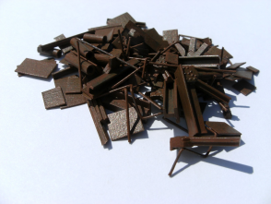
Red giants and supergiant stars
While the outer layers of a red giant / supergiant expand, its core gets smaller
It becomes hot enough for He nuclei to fuse together to form heavier nuclei
The more massive the star, the hotter the core, the heavier the nuclei it can produce by fusion
Red giants – fusion reactions produce nuclei of carbon, then nitrogen and oxygen
Supergiants (core pressure and temp higher) – fusion reactions produce elements with nuclei as heavy as iron!!

Slide 43
Inside stars

Slide 44
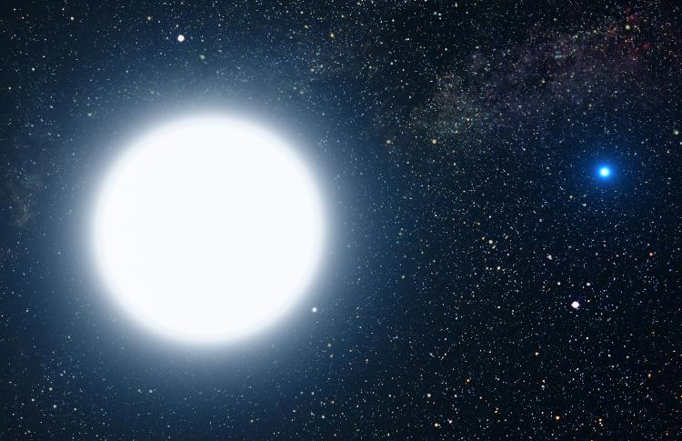
White dwarf stars
The Sun has a relatively low mass
When it becomes a red giant it will not be compressed further once its He has been used up
The star will shrink to become a white dwarf star
There is no fusion in a white dwarf.
It will gradually cool and fade

Slide 45
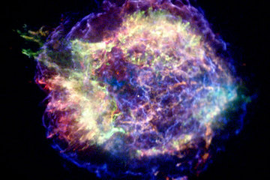
Supernova
When the core of a supergiant is mainly iron, it explodes - this is a supernova
It is so hot that fusion reactions produce atoms of elements as heavy as uranium

Slide 46
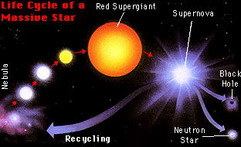
After a supernova explosion, a dense core remains.

Slide 47
After a supernova explosion, a dense core remains.
Smaller core – neutron star
Bigger core – black hole (so much mass concentrated into a tiny space that even light cannot escape from it)

Slide 48
Clouds of dust and gas blown outwards by a supernova may eventually form new protostars

Slide 49
Hertzsprung-Russell diagram
H-R diagram plots luminosity against temperature
For main sequence stars there is a correlation: the hotter the star, the more radiation emitted and so the greater its luminosity

Slide 50
Hertzsprung-Russell diagram
H-R diagram plots luminosity against temperature
For main sequence stars there is a correlation: the hotter the star, the more radiation emitted and so the greater its luminosity

Slide 51
Hertzsprung-Russell diagram
H-R diagram plots luminosity against temperature
For main sequence stars there is a correlation: the hotter the star, the more radiation emitted and so the greater its luminosity
Increasing luminosity
Increasing temperature
HOT COOL

Slide 52
Hertzsprung-Russell diagram
H-R diagram plots luminosity against temperature
For main sequence stars there is a correlation: the hotter the star, the more radiation emitted and so the greater its luminosity
You may be asked to identify regions of the H-R in which different types of star are located

Slide 53
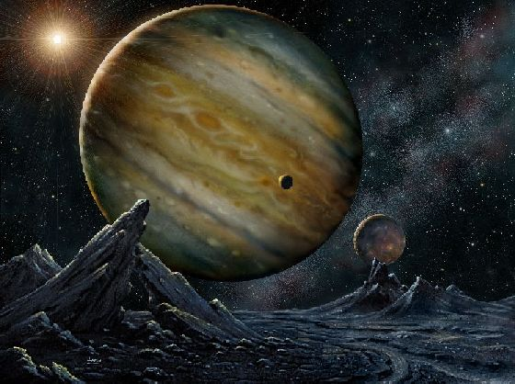
Exoplanets
Astronomers have found evidence of planets orbiting nearby stars.
These are exoplanets
Some may have the right conditions for life
Because of this scientists think there may be life elsewhere in the Universe
No evidence of ET life has yet been discovered
X

Slide 54
P7.5: The astronomy community

Slide 55
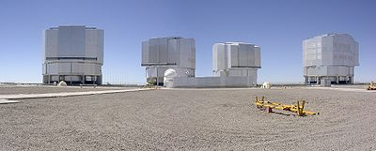
Choosing your observatory site
Astronomers use huge telescopes to collect weak radiation from faint or very distant sources.
Major optical and infrared telescopes on Earth are in:
Chile
Hawaii
Australia
Canary Islands

Slide 56
Choosing your observatory site
When choosing a site, astronomers consider a number of factors
If you have a question in the exam about evaluating telescope sites
Compare the advantages and disadvantages of each site
State with reasons which site you believe to be best

Slide 57
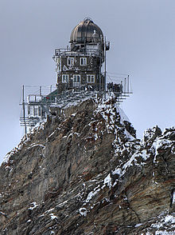
Choosing your observatory site
When choosing a site, astronomers consider a number of factors
Factor | Solution
Atmosphere reflects light This distorts images | Choose a high altitude location (e.g. a mountain) to reduce this problem
The Sphinx Observatory in the Swiss Alps

Slide 58
Choosing your observatory site
When choosing a site, astronomers consider a number of factors
Factor | Solution
Atmosphere reflects light This distorts images | Choose a high altitude location (e.g. a mountain) to reduce this problem
The Sphinx Observatory in the Swiss Alps

Slide 59
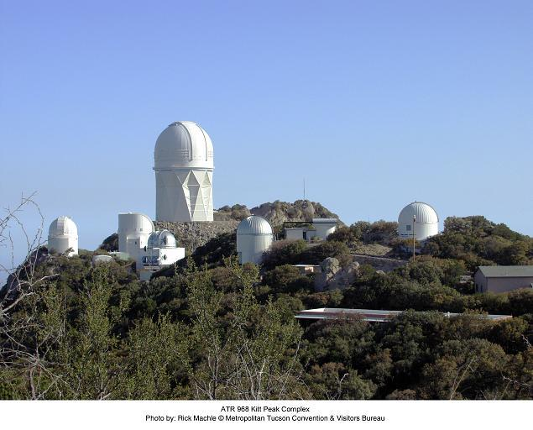
Choosing your observatory site
When choosing a site, astronomers consider a number of factors
Factor | Solution
Light is refracted more if the air is damp or polluted | Locate your telescope in an area with dry, clean air for higher-quality images
Clear skies, dry air and low pollution make Arizona a hotspot for astronomy.

Slide 60
Choosing your observatory site
When choosing a site, astronomers consider a number of factors
Factor | Solution
Light is refracted more if the air is damp or polluted | Locate your telescope in an area with dry, clean air for higher-quality images
Clear skies, dry air and low pollution make Arizona a hotspot for astronomy.

Slide 61
Choosing your observatory site
When choosing a site, astronomers consider a number of factors
Factor | Solution
Astronomical observation cannot be made in cloudy conditions | Choose an area with frequent cloudless nights
Clear skies, dry air and low pollution make Arizona a hotspot for astronomy.

Slide 62
Choosing your observatory site
When choosing a site, astronomers consider a number of factors
Factor | Solution
Astronomical observation cannot be made in cloudy conditions | Choose an area with frequent cloudless nights
Clear skies, dry air and low pollution make Arizona a hotspot for astronomy.

Slide 63
Choosing your observatory site
When choosing a site, astronomers consider a number of factors
Factor | Solution
Cities cause light pollution | Choose an area far from cities
Clear skies, dry air and low pollution make Arizona a hotspot for astronomy.

Slide 64
Choosing your observatory site
When choosing a site, astronomers consider a number of factors
Factor | Solution
Cities cause light pollution | Choose an area far from cities
Clear skies, dry air and low pollution make Arizona a hotspot for astronomy.

Slide 65
Choosing your observatory site
When choosing a site, astronomers consider a number of factors
Other factors:
Cost (inc. travel to and from telescope for supplies and workers)
Environmental impact near the observatory
Impact on local people
Working conditions for employees

Slide 66
Computer controlled telescopes
Allows astronomers to use a telescope thousands of miles away
Images are recorded digitally and sent electronically to computers
Computers can then be used to analyse images and improve their quality (e.g. adding colour)
Observations can then be shared with other astronomers

Slide 67
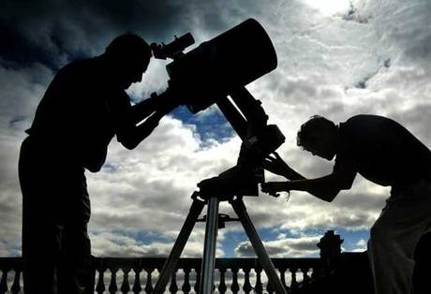
Why put telescopes in space???
Telescopes on Earth are affected by:
Atmosphere (which absorbs most IR, UV, X-ray and gamma radiation)
Atmospheric refraction (distorts images and makes stars ‘twinkle’)
Light pollution
Bad weather

Slide 68
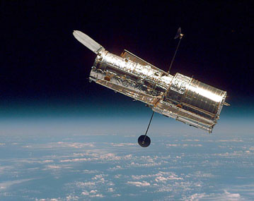
Why put telescopes in space???
Telescopes on Earth are affected by:
Atmosphere (which absorbs most IR, UV, X-ray and gamma radiation)
Atmospheric refraction (distorts images and makes stars ‘twinkle’)
Light pollution
Bad weather
All of these problems are overcome by putting a telescope in space
The Hubble Space Telescope has a better resolution than any telescope on Earth

Slide 69
Problems with telescopes in space???
High cost of setting up
High cost of on-going maintenance and repairing a telescope in space
Uncertainties of future funding

Slide 70
International collaboration
Allows the cost of a major telescope to be shared
Allows expertise to be pooled
Exam tip: Know two examples showing how international co-operation is essential for progress in astronomy

Slide 71
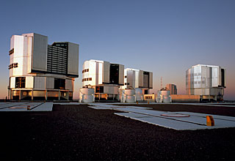
International collaboration – European Southern Observatory (ESO)
Involves 14 European countries + Brazil
Consists of several telescopes in Chile
Chile provides the base and the office staff
1000+ astronomers from all over the world use the facility each year

Slide 72
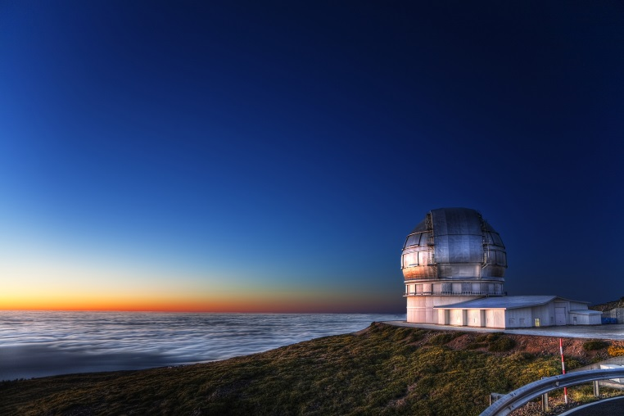
International collaboration – Gran Telescopio Canarias
In the Canary Islands
At the top of a high volcanic peak
Funded mainly by Spain, with contributions from Mexico and the USA
Planning involved 1000+ people from 100 companies

