Slide 1
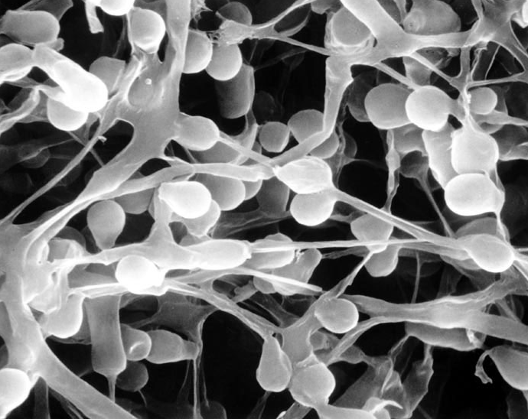
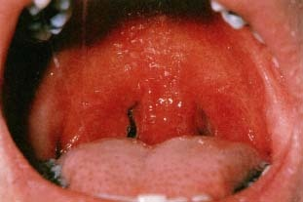
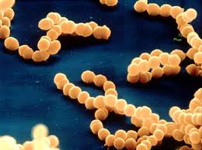
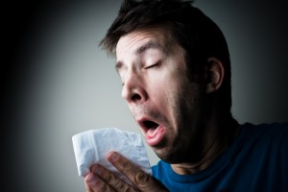
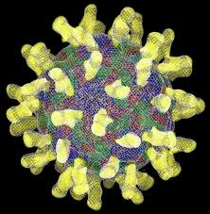
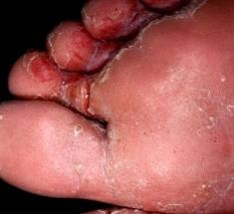
Infectious Disease
Starter: Match these pathogens to the symptoms they cause
A
B
C
1
2
3

Slide 2
Athletes foot - Fungus

Slide 3
Strep Throat - Bacteria

Slide 4
Cold & Influenza (Flu) - Virus

Slide 5
Learning outcomes
State examples of different pathogens and the diseases they cause.
Describe ways in which the body defends itself against disease.
Explain how microbes make us feel ill and how viruses damage cells.

Slide 6
Key words
Microorganism
Infectious disease
Pathogen
Bacteria
Virus
Toxin

Slide 7
Homework
Complete the progress check

Slide 8
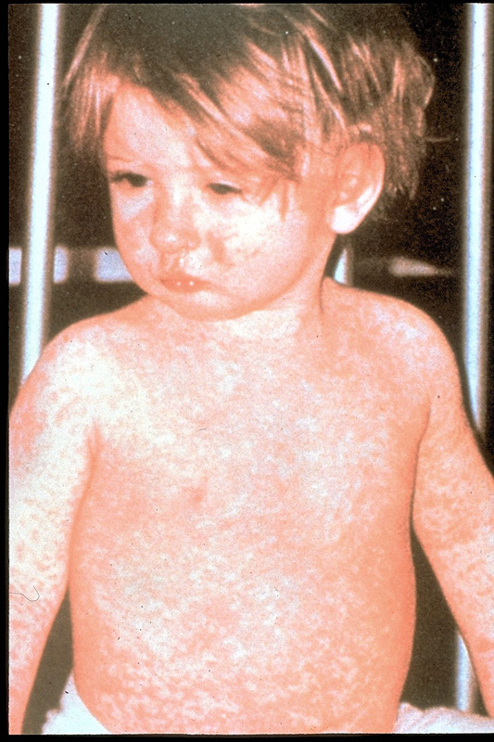
Homework
Make a poster about the causes and prevention of measles.
(Make sure you include enough detail!)

Slide 9
Revision questions
Q: What is a pathogen?
Q: What is the difference between bacteria and viruses?

Slide 10
Disease pathogens - microbes
Bacteria and viruses are the most common of disease pathogens.
Bacteria can survive outside of the host organism. Bacteria can be killed by antibiotics.
Viruses can only survive and reproduce within a host cell. Viruses cannot be destroyed with antibiotics.

Slide 11
Bacteria
This is a pin with bacteria growing on it.

Slide 12
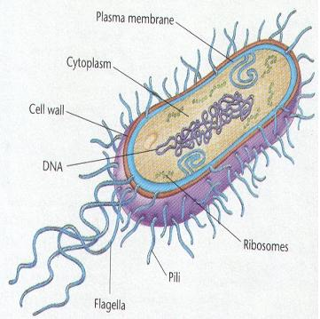
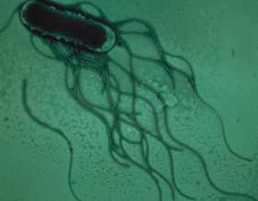
Structure of bacteria
Bacteria produce toxins. These are the poisons that make you feel ill

Slide 13
Viruses – these are much smaller
Virus invade body cells and then hijack the cells DNA to reproduce. This can cause massive cell damage.

Slide 14
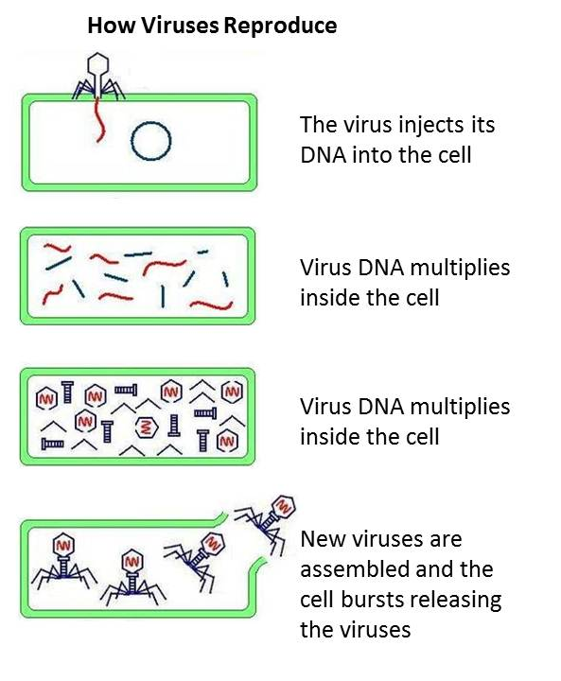
Virus proteins are synthesised inside the cell.

Slide 15
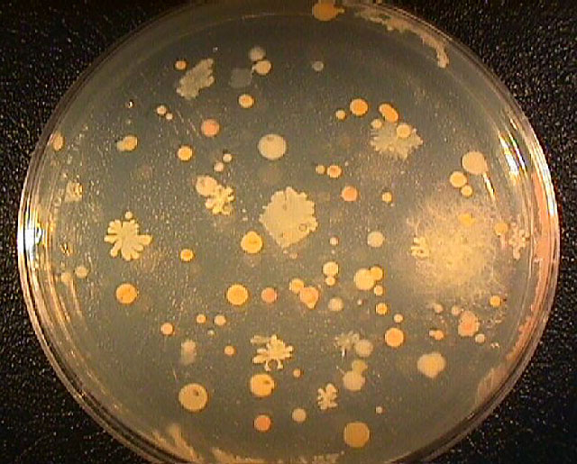
Bacterial Growth
http://www.bbc.co.uk/learningzone/clips/bacterial-growth/209.html

Slide 16
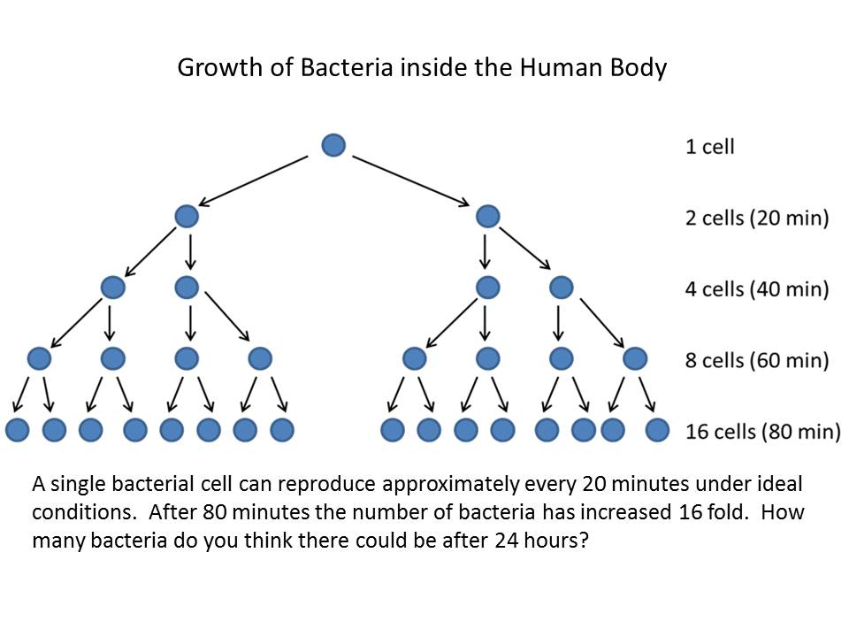
Painkillers such as paracetamol and aspirin help to relieve the symptoms of infectious diseases but they do not kill the pathogens.

Slide 17
Barriers to infection
Q: How does the body protect itself from infection?
http://resources.schoolscience.co.uk/abpi/immune/immune3.html

Slide 18
Q: How does the body protect itself from infection through each of the following routes?
Where can pathogens enter the body?
How the body tries to stop them entering?
Cuts in the skin
Through the nose
Through the eyes
Through food
Skin these are quickly covered by clotted blood (scabs) to keep infection out.
Nose hairs in the nose trap dust and microorganisms. Any which are not stopped by hairs are trapped by sticky mucus in the airways which slowly moves them back to up the throat where they can be swallowed or spat out.
These produce chemicals in tears will kill bacteria
Cuts in the skin
Through the nose
Through the eyes
Through food

Slide 19
Where can pathogens enter the body?
How the body tries to stop them entering?
Cuts in the skin
Through the nose
Through the eyes
Through food
Skin these are quickly covered by clotted blood (scabs) to keep infection out.
Nose hairs in the nose trap dust and microorganisms. Any which are not stopped by hairs are trapped by sticky mucus in the airways which slowly moves them back to up the throat where they can be swallowed or spat out.
These produce chemicals in tears will kill bacteria
Cuts in the skin |  | Nose hairs in the nose trap dust and microorganisms. Those that get through are trapped by sticky mucus in the airways which slowly moves them back to up the throat where they can be swallowed or spat out.
Through the nose |  | Hydrochloric acid in the stomach kills most (but not all) bacteria.
Through the eyes |  | These are quickly covered by clotted blood (scabs) to keep infection out.
Through food |  | Tears contain specific enzymes (known as lysozymes) which kill bacteria.
Match the route of infection to the method of protection.

Slide 20
Where can pathogens enter the body?
How the body tries to stop them entering?
Cuts in the skin
Through the nose
Through the eyes
Through food
Skin these are quickly covered by clotted blood (scabs) to keep infection out.
Nose hairs in the nose trap dust and microorganisms. Any which are not stopped by hairs are trapped by sticky mucus in the airways which slowly moves them back to up the throat where they can be swallowed or spat out.
These produce chemicals in tears will kill bacteria
Cuts in the skin |  | These are quickly covered by clotted blood (scabs) to keep infection out.
Through the nose |  | Nose hairs in the nose trap dust and microorganisms. Those that get through are trapped by sticky mucus in the airways which slowly moves them back to up the throat where they can be swallowed or spat out.
Through the eyes |  | Tears contain specific enzymes (known as lysozymes) which kill bacteria.
Through food |  | Hydrochloric acid in the stomach kills most (but not all) bacteria.
Answers!

Slide 21
Where can pathogens enter the body?
How the body tries to stop them entering?
Cuts in the skin
Through the nose
Through the eyes
Through food
Skin these are quickly covered by clotted blood (scabs) to keep infection out.
Nose hairs in the nose trap dust and microorganisms. Any which are not stopped by hairs are trapped by sticky mucus in the airways which slowly moves them back to up the throat where they can be swallowed or spat out.
These produce chemicals in tears will kill bacteria
Cuts in the skin |  | Skin these are quickly covered by clotted blood (scabs) to keep infection out.
Through the nose |  | Nose hairs in the nose trap dust and microorganisms. Any which are not stopped by hairs are trapped by sticky mucus in the airways which slowly moves them back to up the throat where they can be swallowed or spat out.
Through the eyes |  | These produce chemicals in tears will kill bacteria
Through food |  | Food acid in the stomach kills most (but not all) bacteria.

Slide 22
3-2-1-Plenary
3 things you’ve learnt today
2 things that you are unsure on
1 thing that you are going to go away and read about

