Slide 1
Immunity
Objective
Understand the action of white cells in the body and the processes of natural and acquired immunity
Starter
Last lesson you learnt about the body’s first line of defence. What was this ?
Give as many examples as you can.

Slide 2
First line of defence
The body’s first line of defence are the barriers your body has to prevents the entrance of pathogens.
E.g.
Skin
Stomach acid
Mucus and hairs in the nose and throat
Enzymes in tears and saliva

Slide 3
Immunity
Outcomes
State the definitions of keywords
Describe the actions of white blood cells using the terms ‘ingest’, ‘antibodies’ and ‘antitoxins’.
Explain the processes of natural and acquired immunity.

Slide 4
Activity:
Try and match the following keywords with your
definition sheet (you will not know them all)
Pathogen | 病原 | kórokozó | מחולל מחלה | پاتوژن
Toxin | 毒素 | toxin | רעלן | زهرابه
immune system | 免疫系统 | immunrendszer | מערכת חיסונית | سیستم ایمنی بدن
Antibody | 抗体 | ellenanyag | נוגדן | پادتن
phagocyte | 吞噬细胞 | falósejt | תא בלען | سلول بیگانه خوار
Antigen | 抗原 | antigén | אנטיגן | پادگن
Lymphocyte | 淋巴细胞 | limfociták | לימפוציטים | لنفوسیت ها

Slide 5
Immunity
keyword | Definition
 | A micro-organism that causes disease.
 | A poisonous or toxic substance made by pathogens
 | Protein made by white blood cell attaches to a specific antigen
 | Molecule on the surface of a pathogen that identifies it as a foreign invader.
 | The body’s natural defence mechanism against infectious diseases.
 | A type of white blood cell that ingests pathogen
 | A type of white blood cell that makes antibodies to fight off infection.

Slide 6
keyword | Definition
Pathogen | A micro-organism that causes disease.
Toxin | A poisonous or toxic substance made by pathogens
Antibody | Protein made by white blood cell attaches to a specific antigen
Antigen | Molecule on the surface of a pathogen that identifies it as a foreign invader.
Immune system | The body’s natural defence mechanism against infectious diseases.
Phagocyte | A type of white blood cell that ingests pathogen
Lymphocyte | A type of white blood cell that makes antibodies to fight off infection.

Slide 7
If a pathogen gets through your first line of defence a second line of defence is activated.
What is your body’s second line of defence?

Slide 8
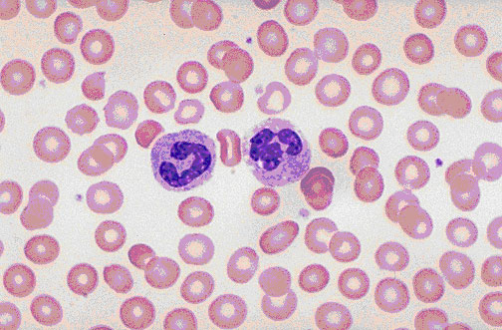
White blood cells
Blood as seen under
the microscope.
Can you identify
the cells ?

Slide 9
Mostly you can see red cells. The ones with a blue nucleus are the white blood cells, stained so they
are visible.

Slide 10
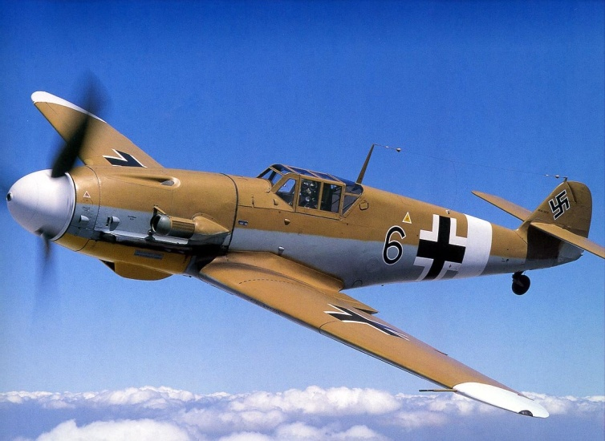
Friend or foe?
The surface of every cell is covered with molecules called antigens.
There are millions of different antigens and each one has a unique shape recognised by white blood cells.
If a pathogen enters your body your white cells quickly recognise the foreign antigens. and triggers off an immune response.

Slide 11
Action of white blood cells in an immune response
There are 3 actions:
1. Producing antibodies, which destroy pathogens http://www.abpischools.org.uk/res/coResourceImport/modules/infectiousdiseases_immunity/fullscreenflash2-1.cfm
(white cells that do this are lymphocytes)

Slide 12
Different pathogens have different antigens so a different antibody is needed to recognise each different type of antigen.

Slide 13
2. By ingesting pathogens http://www.bbc.co.uk/learningzone/clips/white-blood-cells/1838.html
http://www.abpischools.org.uk/res/coResourceImport/modules/infectiousdiseases_immunity/fullscreenflash2-2.cfm
(White cells that do this are called phagocytes)

Slide 14
3. Producing antitoxins, which counteract the toxins released by the pathogens and so stop them from damaging the body’s cells.
White blood cells are found all over your body, but especially the lymph glands. These glands often become swollen when your body is mounting an immune response against a pathogen, which is what is described as having swollen glands.

Slide 15
Activity
Use the diagrams provided to show how white blood cells deal with a pathogen like bacteria invading the body.
Keywords to add (optional):
ingest
antibodies
antigens
antitoxins
bacterium
white blood cells
(if you want you can name the white cells phagocytes, lymphocytes)

Slide 16
Natural acquired immunity
Pathogen
The way in which white blood cells fight disease is described as natural acquired immunity.

Slide 17
Natural acquired immunity
Pathogen
Pathogen
Pathogen
Pathogen
It takes a few days before the response is large enough to fight off an infection.
This is partly because the white blood cells need to “learn” how to make the antibodies to fight a particular pathogen.
During this time, the pathogens can multiply and damage to the body tissues will happen
You will feel the symptoms of the infection.

Slide 18
Natural acquired immunity
Pathogen
Pathogen
Pathogen
Pathogen
Once the white blood cell has “learned” how to make the antibodies, it can produce them much more quickly.
With most infections you will produce enough antibodies to kill the pathogens causing the infection and the symptoms disappear.
Once this happens your immune system switches off its response to this infection.

Slide 19
Natural acquired immunity
Pathogen
Even after being “switched off” The white blood cells “remember” how to produce the antibodies to fight the pathogens.
This means that, if you are infected by the same pathogen in the future, the response will be quicker, meaning that less damage is done to your body.

Slide 20
Discuss these questions with your partner
Which infectious disease have you had?
When you had a disease why did you recover?
If you have a disease are you likely to have it again?
If you had the measles and came in contact with someone who had chicken pox would you be protected?

Slide 21
Vaccination
Dead/weak
Vaccination works by deliberately infecting a person with a dead or weakened version of the pathogen.
The white blood cells “learn” how to produce antibodies to fight the pathogen.

Slide 22
Vaccination
Dead/weak
The dead/weakened pathogen is unable to significantly damage the body while the white blood cells are responding
Therefore you don’t feel as ill as if you had been infected by a full-strength pathogen.

Slide 23
Vaccination
Pathogen
If you then get infected by the full strength pathogen, the white blood cells can respond quickly.
This fights off the infection before the pathogen has a chance to multiply.

