Slide 1
Medicines
Objective :
Understand how the use of medicines has helped
those suffering from a disease.
Understand the importance of the work of Semmelweiss and its relevance in hospitals today.
Starter:
List as many symptoms which can be shown when you have an infection.

Slide 2
List as many symptoms of an infection.
How many of these did you write down ?
Inflammation, pain, headache, itchy rash, redness,flush,
Dehydration, soreness, fatigue, shivering, chills, aching,
Diarrhoea, fever, sweating, cough, nausea, vomiting, sneezing, cramp, shortness of breath, numbness,

Slide 3
Discuss with your partner
What causes the symptoms ?
Why do people take medicines ?
Why do people not like to take medicines ?

Slide 4
What causes the symptoms ?
The antigens, toxins produced by the pathogens and the damage done to cells.
why do people take medicines ?
To relieve symptoms e.g. soothe rash, stop pain
To make us feel better
To kill the infection.
Why do people not like to take medicines ?
Afraid of possible side effects and addiction

Slide 5
Life expectancy
One hundred years ago a child born in England could expect to live to 55 if it was a girl or 51 if it was a boy.
A girl born in the UK in 2006-8 is expected to live on average to 81 and a boy to 77. This increase is in part due to modern medicine.

Slide 6
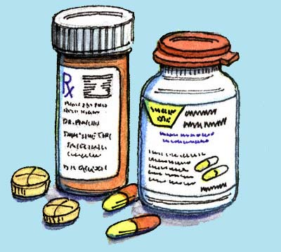
List as many medicines used to relieve symptoms and treat diseases

Slide 7
Which of these are antibiotics ?
Penicillin, aspirin, codeine, amoxicillin, Ibuprofen,
Ampicillin, morphine, flucloxacillin.
What group would you put the others under ?

Slide 8
Which of these are antibiotics ?
Penicillin, amoxicillin,
Ampicillin, flucloxacillin.
What group would you put the others under ?
painkillers

Slide 9
Antimicrobials
These are chemical which destroy microorganisms such as bacteria , fungi and viruses.
Antibiotics such as penicillin are used to treat bacterial infection. The antibiotic weakens and ruptures the cell walls so the bacterium dies. Antibiotics have saved millions of lives around the world. Since they were first discovered by Alexander Fleming.
http://www.bbc.co.uk/learningzone/clips/fleming-and-the-discovery-of-penicillin/1837.html

Slide 10
Antibiotics cannot be used to destroy viruses. This is because viruses only reproduce inside other cells, so it is very difficult to develop drugs that kill viruses without also damaging the body’s tissues. Different bacteria are treated with different antibiotics.
Activity: Answer these questions .
Who found penicillin?
What can antibiotics be used to treat and how do they work?
Why cant antibiotics be used to destroy viruses?

Slide 11
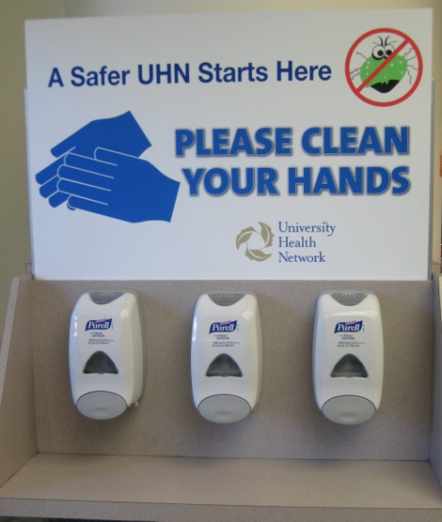
Antiseptic hand wash and hand rub products kill disease-causing microorganisms on the skin and reduce the spread of communicable illnesses in health care settings. Read the article on the work of Semmelweiss. Write a paragraph
summarising his work.
How is it relevant to
hospitals today ?

Slide 13
Plenary
State 3 facts you have learnt today.

