Slide 1
Determining time of death- Lesson 4
Friday, 12 June 2015
Key words: Forensic entomology, Succession
Starter: Which would be more useful when trying to identify the time of death?
Stages of decomposition
Temperature of the body
Rigor mortis
Think of how to justify your answer.

Slide 2
The big picture: “How can we use insects to estimate time of death?”
Learning outcomes
To describe how the lifecycle of insects can be used to investigate time of death.
To analyse the succession of organisms and how environmental conditions may alter the lifecycle.
To calculate an estimated time of death using graphs.

Slide 3
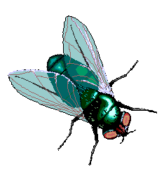
What is Forensic Entomology?
Forensic Entomology is the use of the insects, and their arthropod relatives, that inhabit decomposing remains to aid legal investigations.
Forensic entomologists must identify the species present on the body and work out which stage of its lifecycle it is in.
They also have to look at the environmental conditions, as these can alter the lifecycle.

Slide 4
Succession of insects on a body
Succession= how an ecosystem has changed over time
(you will learn more about this in topic 5).
This process involves new organisms colonising an area over time and sometimes being replaced by other organisms due to competition.
Succession turns simple ecosystems into more complex and varied ones e.g. bare land can become forest over thousands of years.
This process occurs on a body with the range of species present changing over time.

Slide 5
Video: Forensic entomology
http://www.youtube.com/watch?v=2vv4RW2AFxM

Slide 6
Determining time of death
Over the next few lessons you will be producing a leaflet/ guide with the title
“How to determine the time of death”
Each lesson you will learn about/ work on one chapter/section of your guide.
Today’s topic: Forensic entomology
Resources: Text books, phones, fact sheets

Slide 7
Exam questions
Try the exam questions on determining time of death using temperature.
Time allowed: 12 minutes

Slide 8
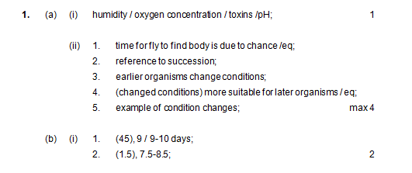
Self-assessment

Slide 9
Self-assessment

Slide 10
Resources

Slide 11
Forensic entomology
Grade E: What is forensic entomology?
Grade D: What information would a forensic entomologist collect from the scene?
Grade C: How are the insects used to determine the time of death? Include the stages of the blow fly life cycle.
Grade B: What factors affect the growth of insects on a corpse?
Grade A: Explain the different stages of succession on a corpse.

Slide 12
Forensic entomology
Grade E: What is forensic entomology?
Grade D: What information would a forensic entomologist collect from the scene?
Grade C: How are the insects used to determine the time of death? Include the stages of the blow fly life cycle.
Grade B: What factors affect the growth of insects on a corpse?
Grade A: Explain the different stages of succession on a corpse.

